Slide 1
Select
Cletus Emmanuel

Slide 2
Loading required packages
tidyverse
readxl
magick
knitr

Slide 3
Load trial file
## * TMS19F1219P0180

Slide 4
Load images
Select a directory and load the images
## [1] "2022-21.GS.C4.AYT.45.IB-rep1-IITA-TMS-IBA000070_108_Photos_1_2022-06-29-09-16-58.jpg" ## [2] "2022-21.GS.C4.AYT.45.IB-rep1-IITA-TMS-IBA000070_108_Photos_2_2022-06-29-09-17-10.jpg" ## [3] "2022-21.GS.C4.AYT.45.IB-rep1-IITA-TMS-IBA000070_108_Photos_3_2022-06-29-09-27-07.jpg" ## [4] "2022-21.GS.C4.AYT.45.IB-rep1-IITA-TMS-IBA070593_141_Photos_1_2022-06-29-10-42-22.jpg" ## [5] "2022-21.GS.C4.AYT.45.IB-rep1-IITA-TMS-IBA070593_141_Photos_2_2022-06-29-11-33-52.jpg" ## [6] "2022-21.GS.C4.AYT.45.IB-rep1-IITA-TMS-IBA30572_105_Photos_1_2022-06-29-09-03-47.jpg"
Find specific genotype image
Render the summary statistics for each genotype in the trial
Load all the images of the selected clones for this trial

Slide 5
Genotype: TMS19F1219P0180
Trait | Value
Genotype | TMS19F1219P0180
MCMDS | 1
FYLD | 45.7
DYLD | 14.92
DM | 32.47
SI | 277.97

Slide 6
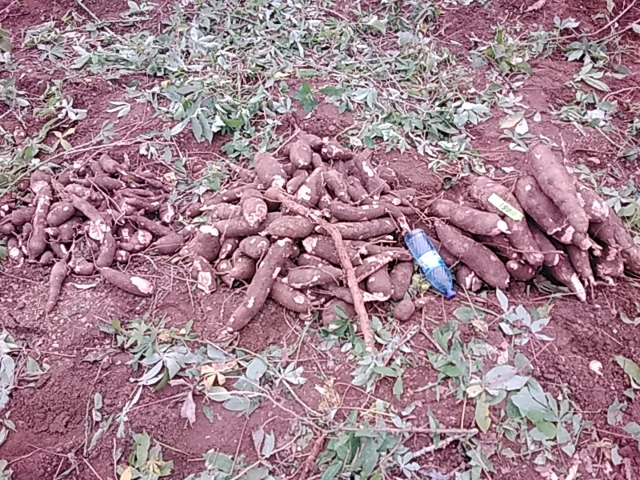

Slide 7
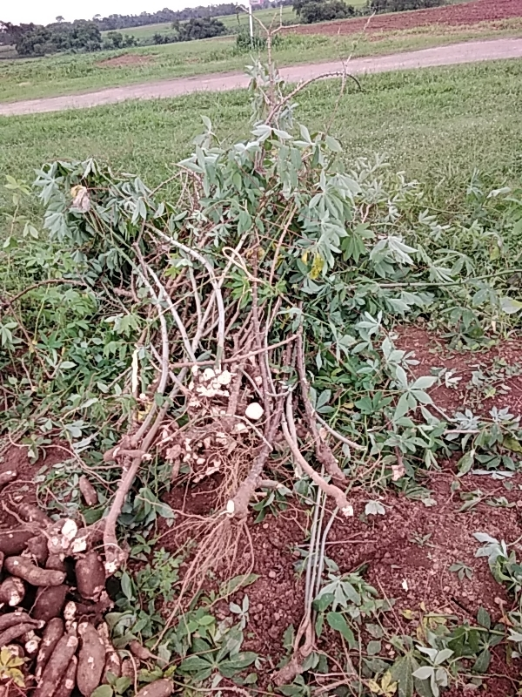

Slide 8
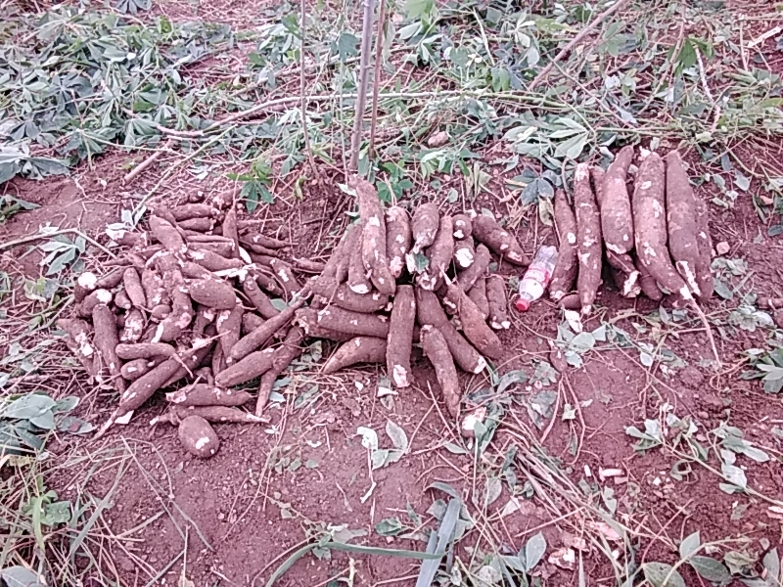

Slide 9
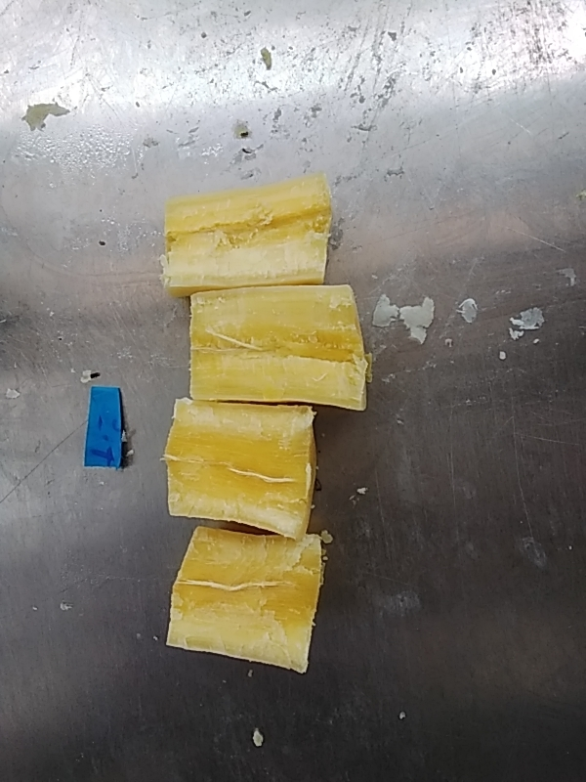

Slide 10
Genotype: TMS19F1011P0025
Trait | Value
Genotype | TMS19F1011P0025
MCMDS | 1
FYLD | 36.06
DYLD | 12.72
DM | 35.04
SI | 214.18

Slide 11
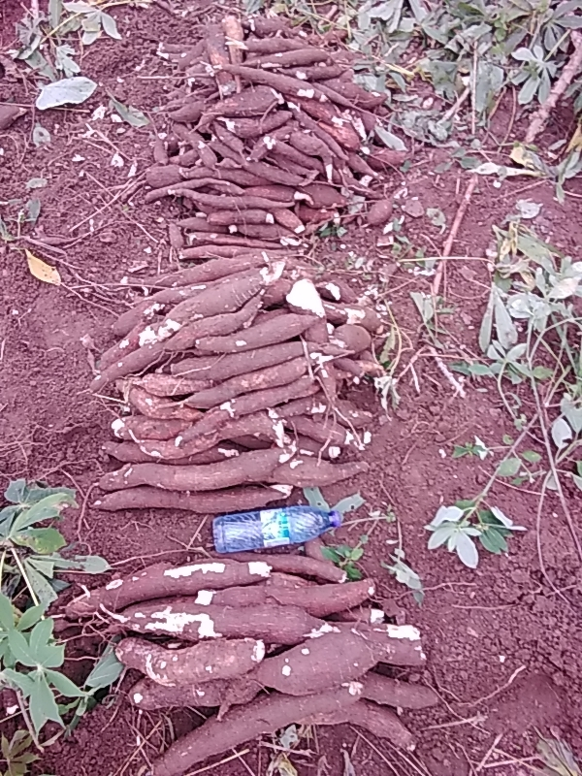

Slide 12
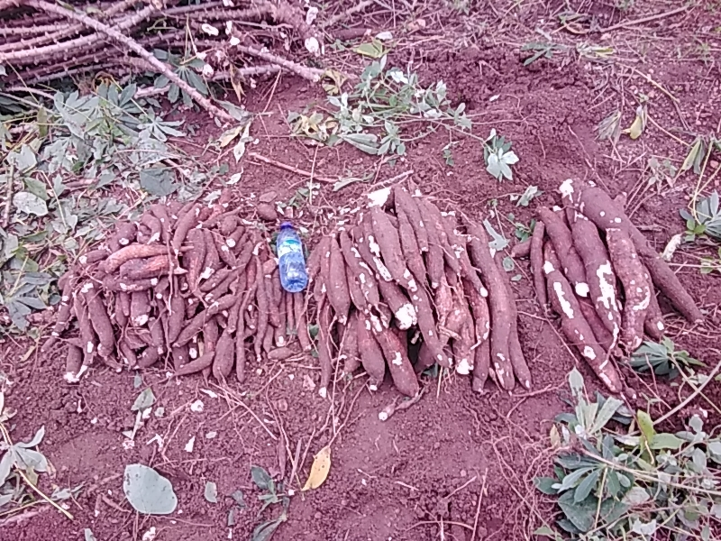

Slide 13
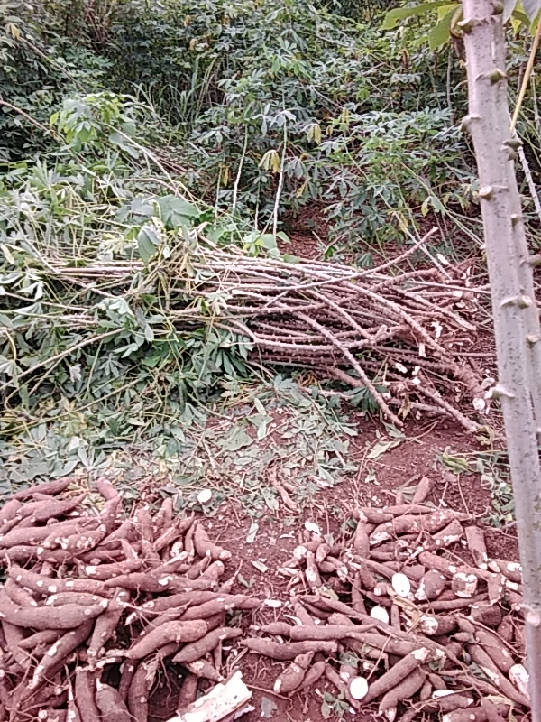

Slide 14
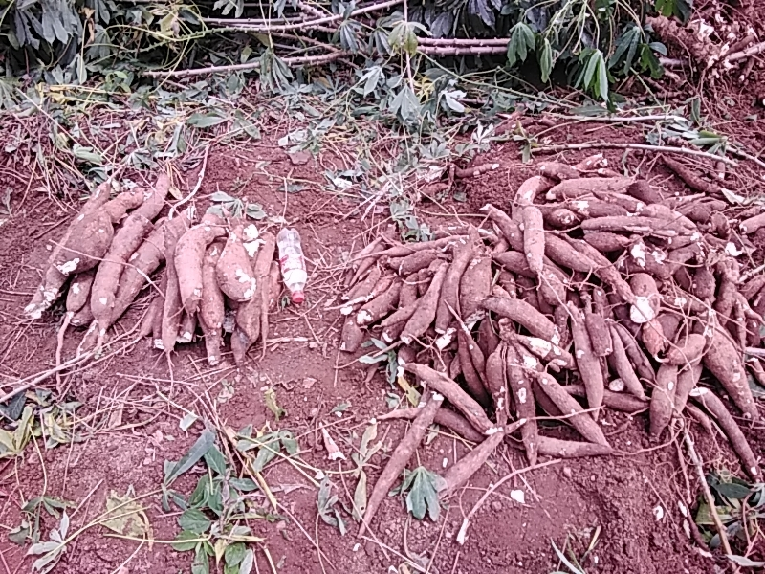

Slide 15
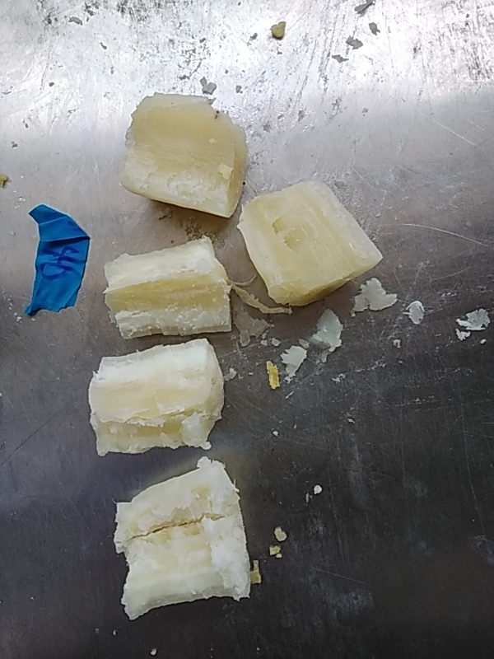

Slide 16
Genotype: TMS19F1210P0006
Trait | Value
Genotype | TMS19F1210P0006
MCMDS | 1
FYLD | 34.55
DYLD | 11.43
DM | 33.05
SI | 155.55

Slide 17
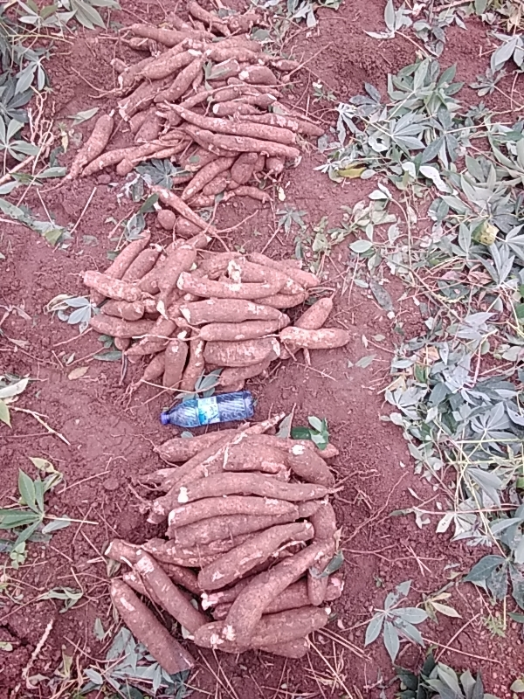

Slide 18
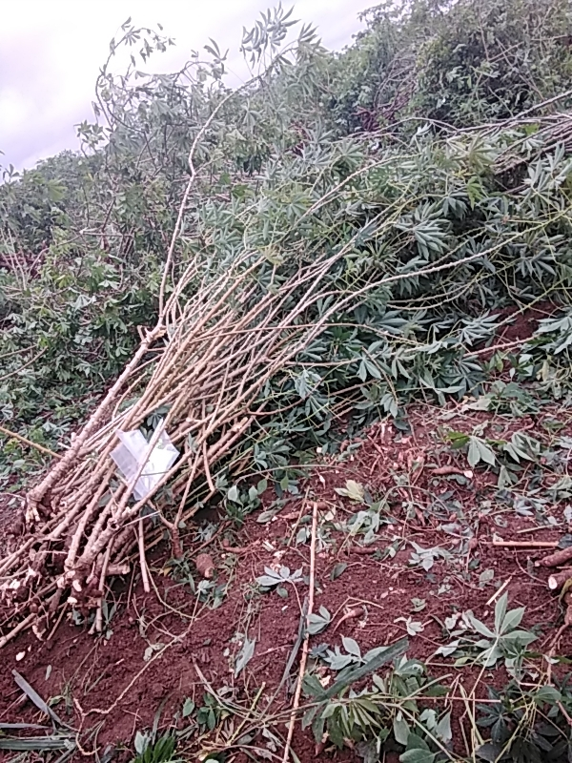

Slide 19
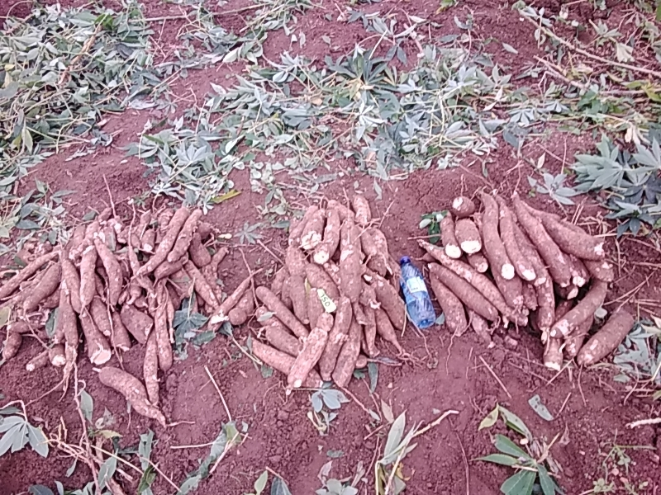

Slide 20
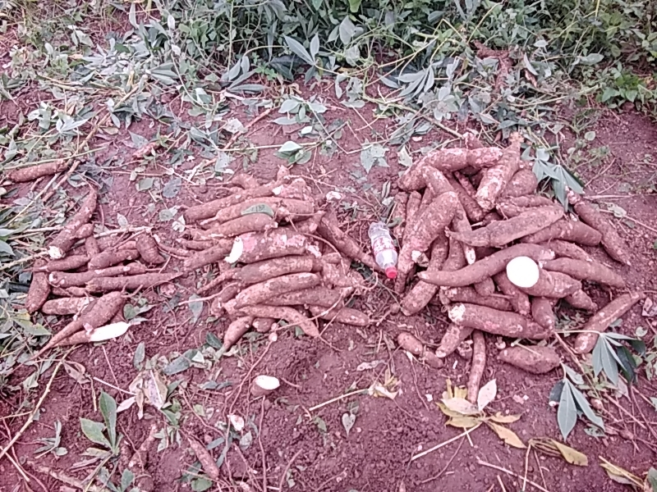

Slide 21
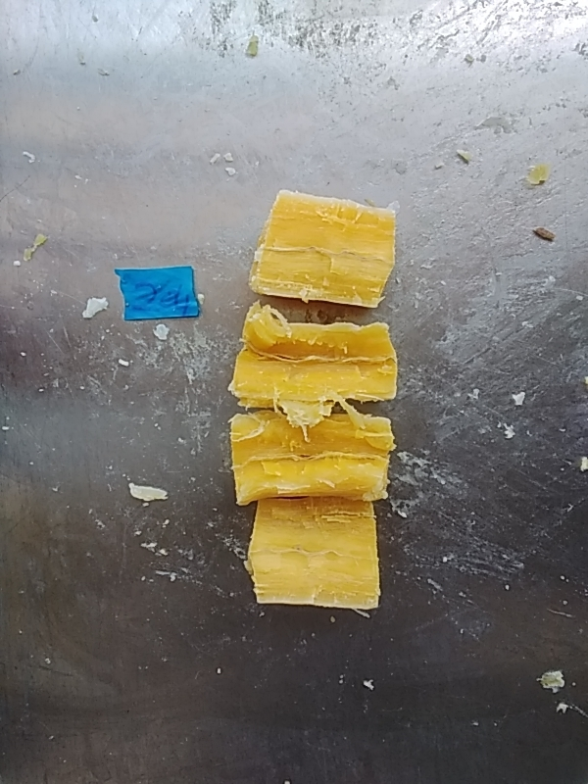

Slide 22
Genotype: TMS19F1219P0089
Trait | Value
Genotype | TMS19F1219P0089
MCMDS | 1.24
FYLD | 34.32
DYLD | 11.68
DM | 33.93
SI | 149.11

Slide 23
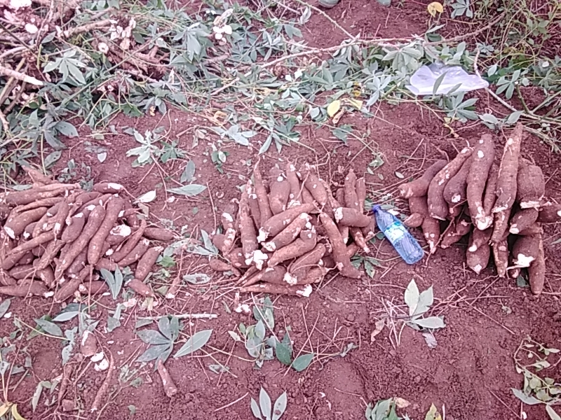

Slide 24
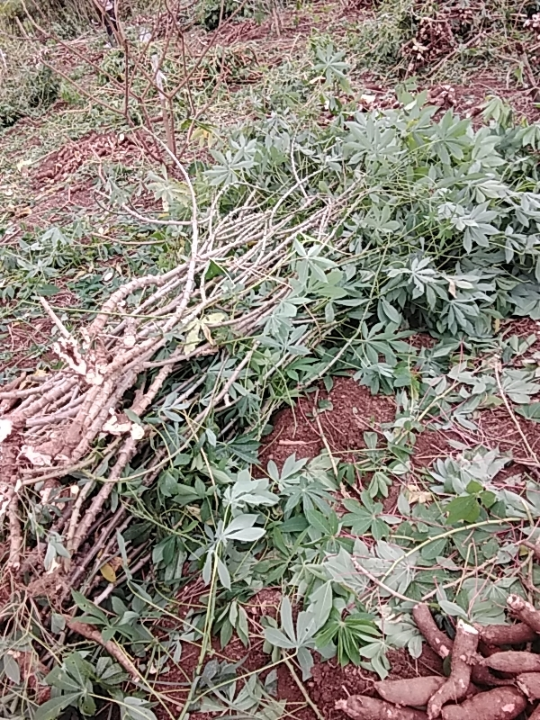

Slide 25
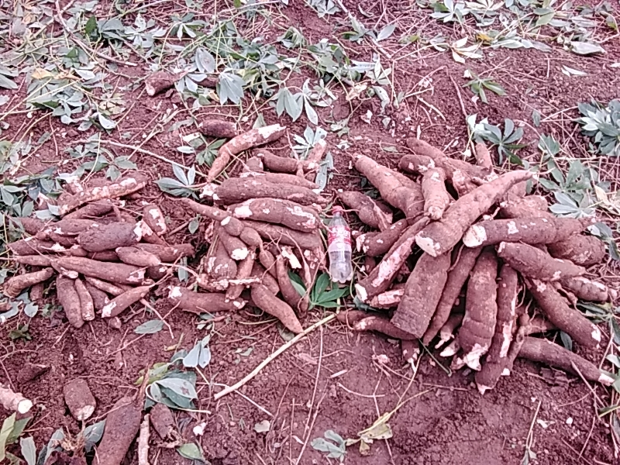

Slide 26
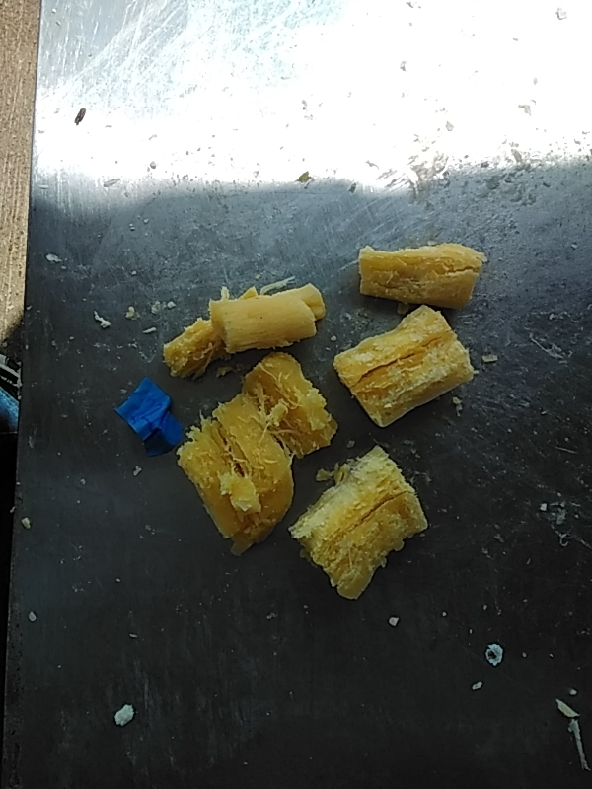

Slide 27
Genotype: TMS19F1194P0076
Trait | Value
Genotype | TMS19F1194P0076
MCMDS | 1
FYLD | 33.82
DYLD | 10.83
DM | 32.15
SI | 139.54

Slide 28
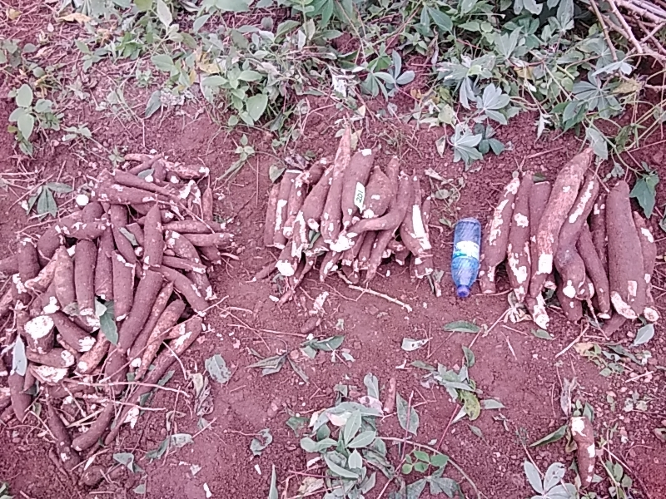

Slide 29
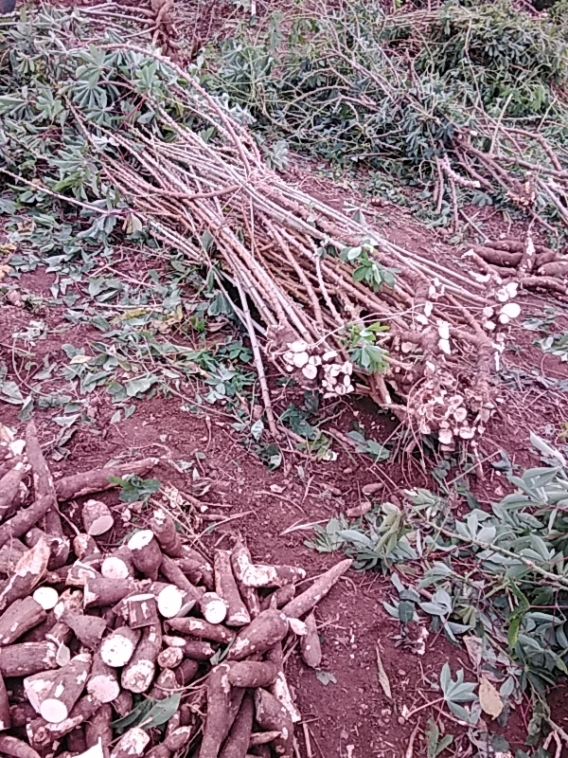

Slide 30
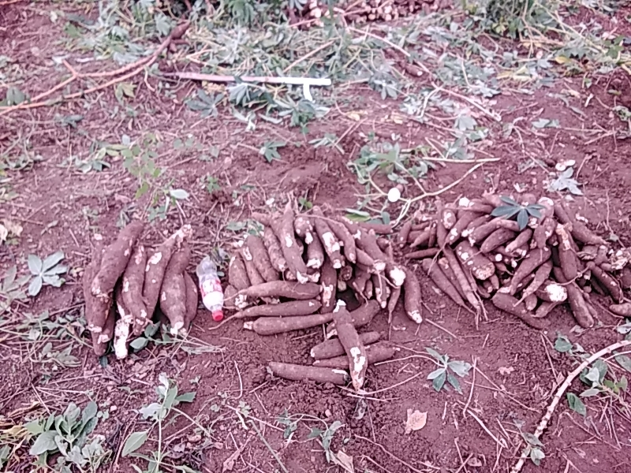

Slide 31
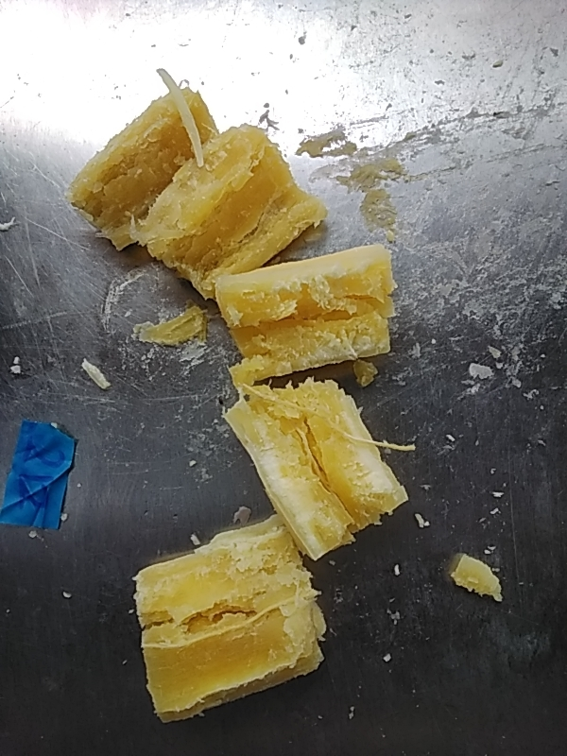

Slide 32
Genotype: TMS19F1224P0002
Trait | Value
Genotype | TMS19F1224P0002
MCMDS | 1
FYLD | 34.43
DYLD | 10.68
DM | 31.3
SI | 114.37

Slide 33
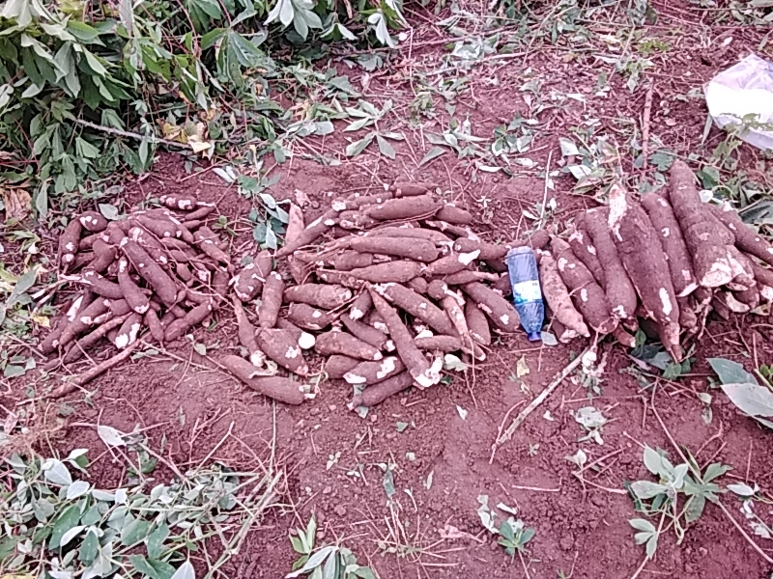

Slide 34
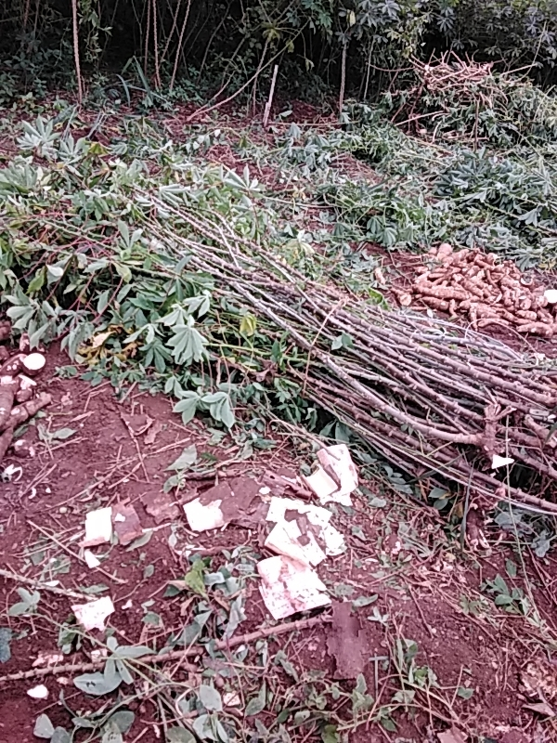

Slide 35
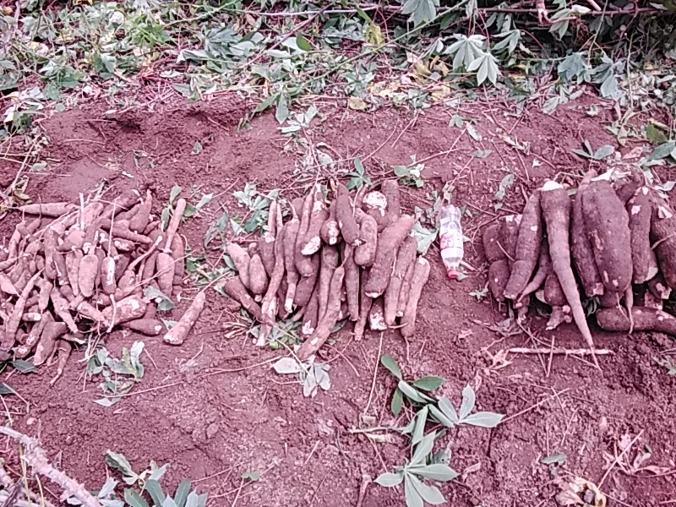

Slide 36
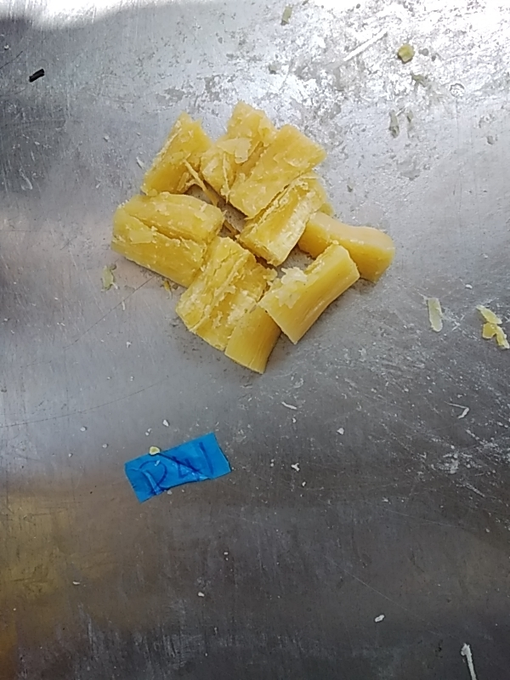

Slide 37
Genotype: TMS19F1371P0025
Trait | Value
Genotype | TMS19F1371P0025
MCMDS | 1
FYLD | 33.82
DYLD | 10.38
DM | 30.97
SI | 105.3

Slide 38
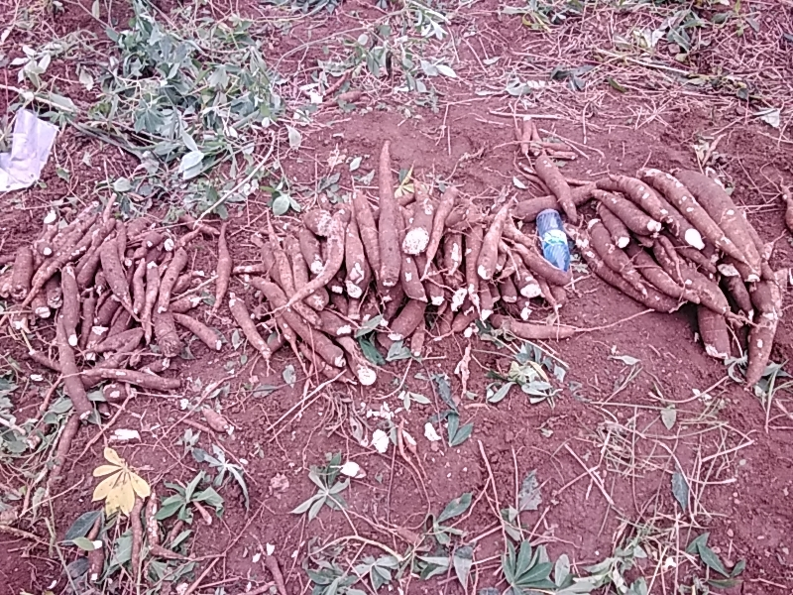

Slide 39
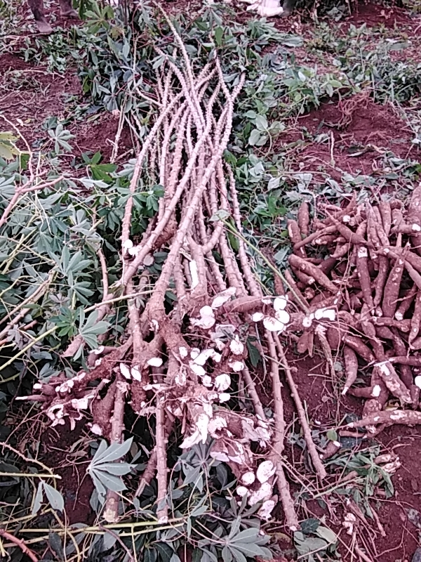

Slide 40
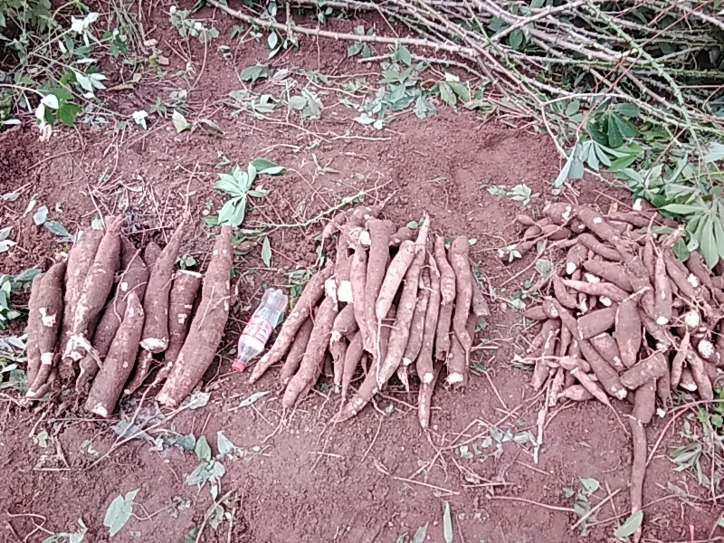

Slide 41
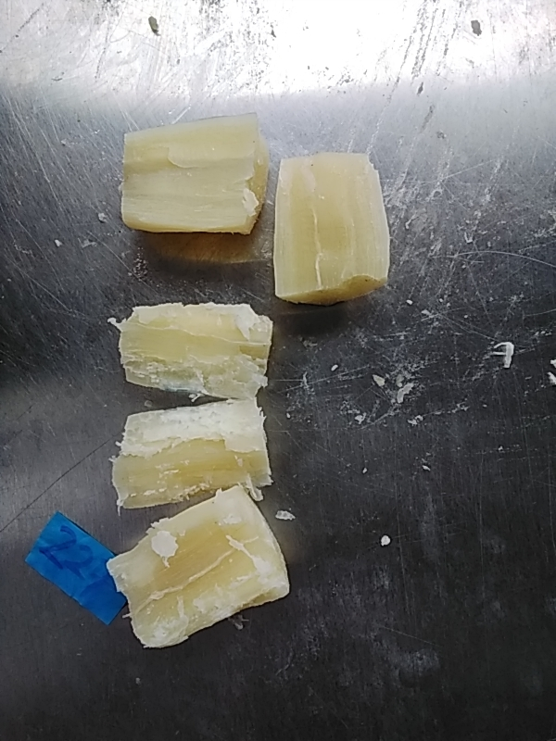

Slide 42
Genotype: TMS19F1225P0010
Trait | Value
Genotype | TMS19F1225P0010
MCMDS | 1
FYLD | 24.98
DYLD | 8.59
DM | 34.1
SI | 9.08

Slide 43
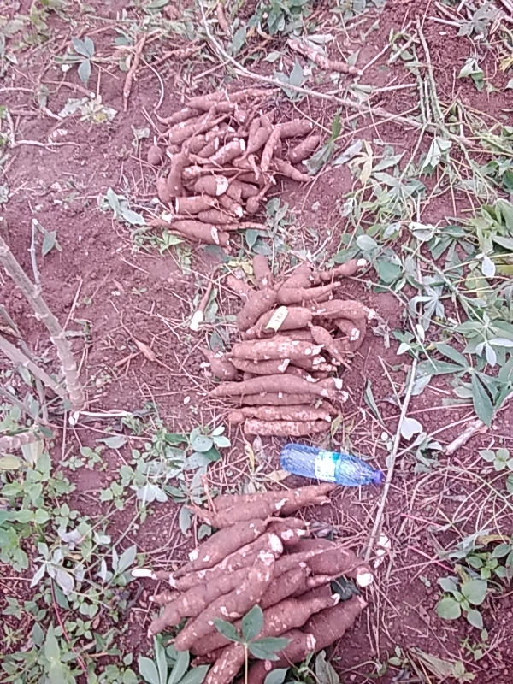

Slide 44
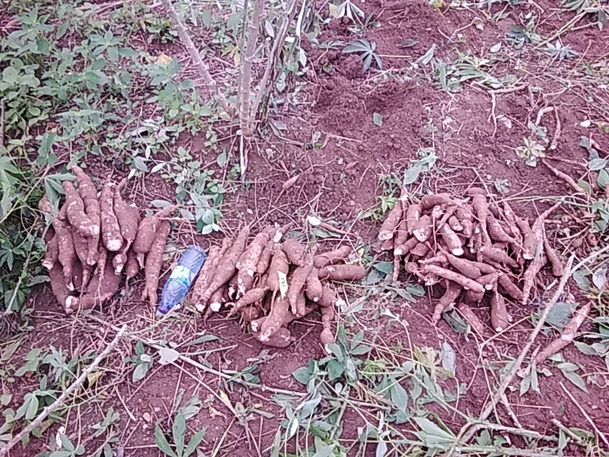

Slide 45
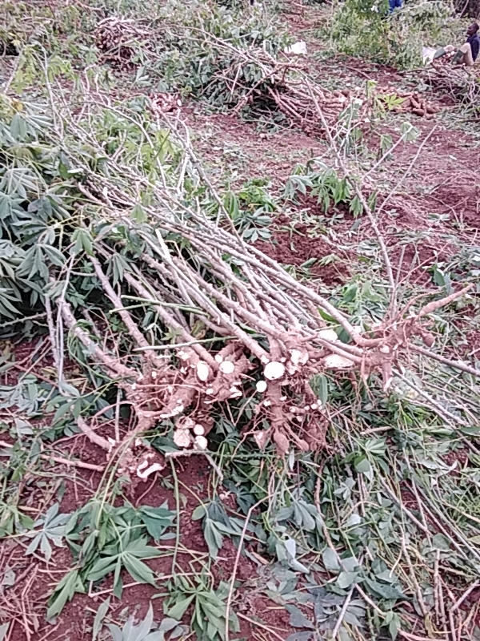

Slide 46
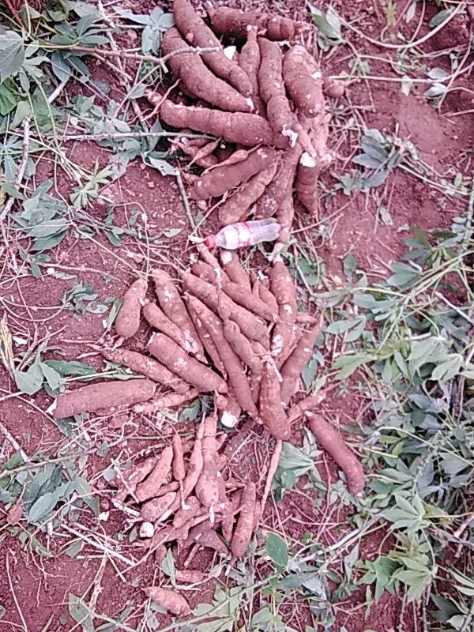

Slide 47
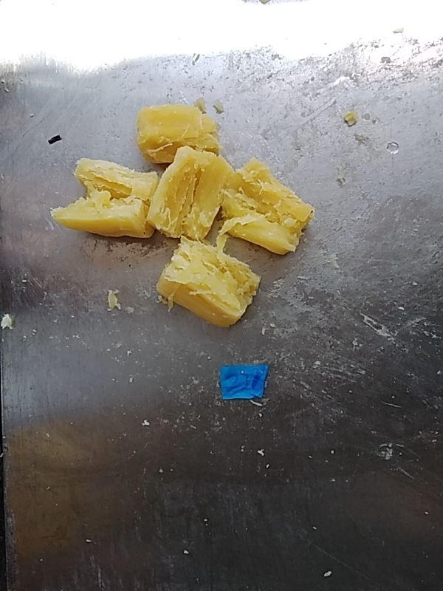

Slide 48
Genotype: TMS19F1219P0003
Trait | Value
Genotype | TMS19F1219P0003
MCMDS | 1
FYLD | 22.93
DYLD | 7.94
DM | 34.69
SI | -22.76

Slide 49
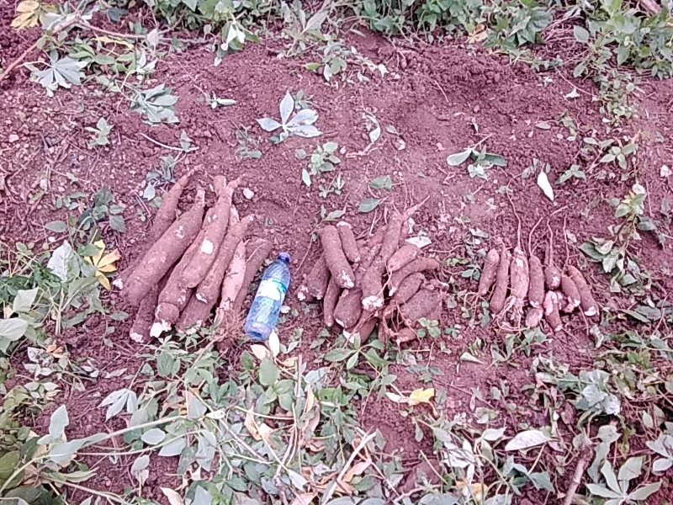

Slide 50
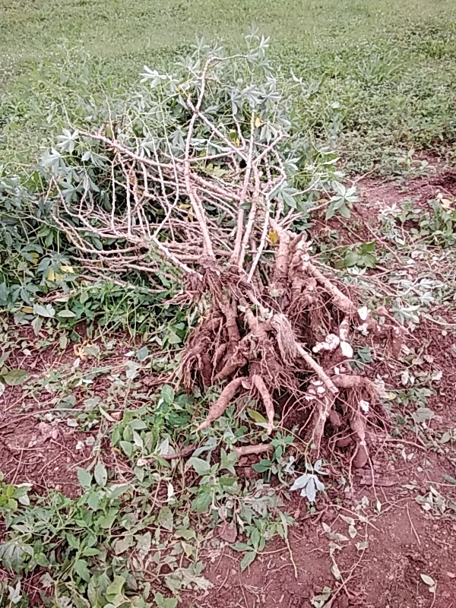

Slide 51
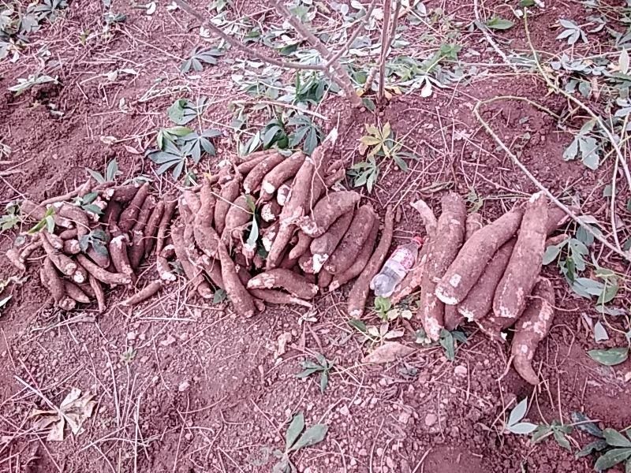

Slide 52
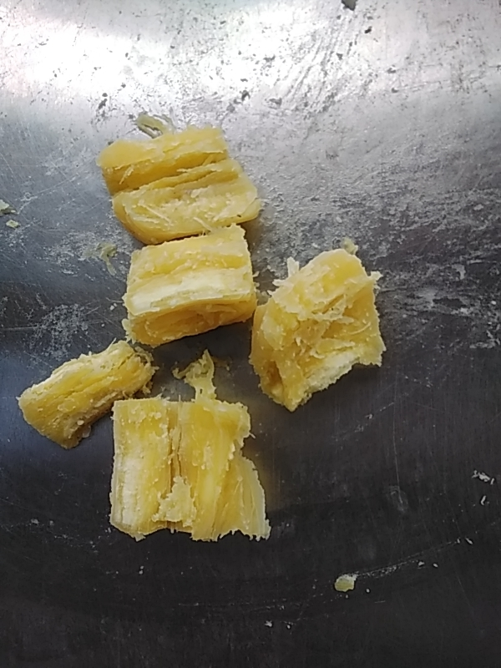

Slide 53
Genotype: TMS19F1194P0103
Trait | Value
Genotype | TMS19F1194P0103
MCMDS | 1
FYLD | 21.86
DYLD | 7.47
DM | 33.95
SI | -35.8

Slide 54
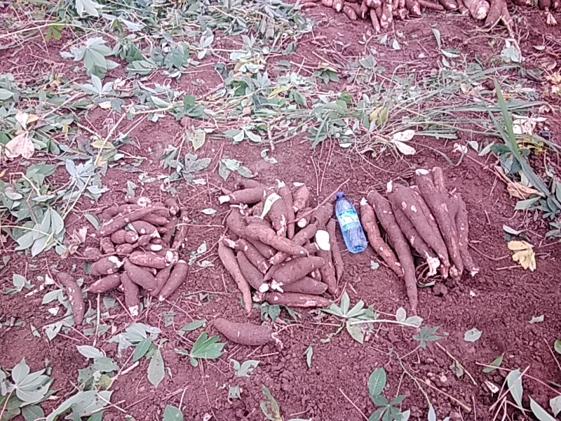

Slide 55
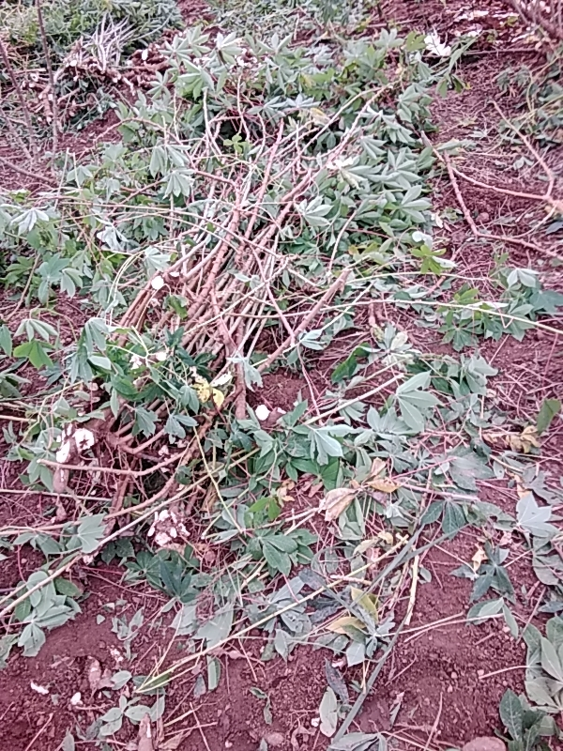

Slide 56
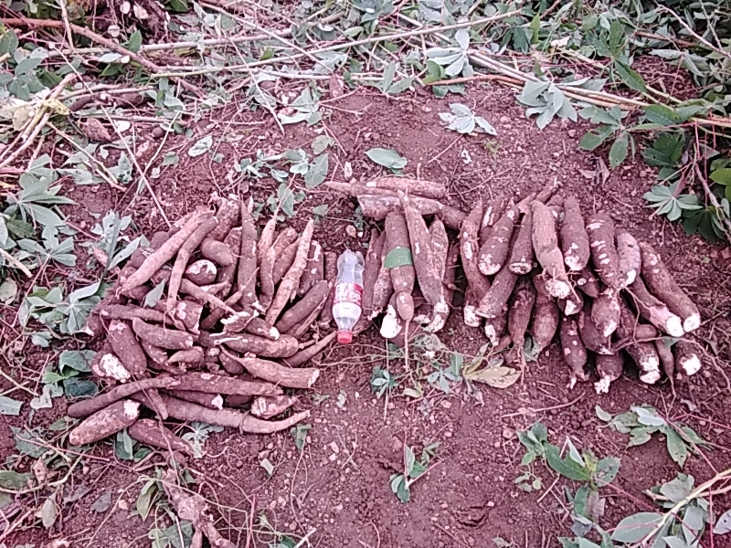

Slide 57
